Slide 1


Python Coding Session I/O
Introduction to Implementation Details and Usage

Slide 2

Introduction
In Python, input and output commands are used to interact with the user and display information.
Input: input(prompt): Prompts the user to enter input and returns the entered value as string
Output: print(string): display one message on console, allowing it to be visible for the user

Slide 3
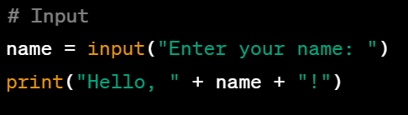
Input

Slide 4
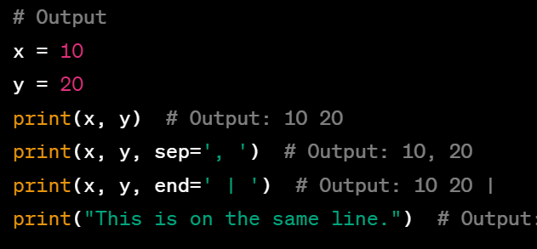
Output

Slide 5
Pratice Operators + Inputs + Outputs
Exercise 1: Arithmetic Operations, Write a program that prompts the user to enter two numbers and performs the following operations:
Add the two numbers and display the result.
Subtract the second number from the first number and display the result.
Multiply the two numbers and display the result.
Divide the first number by the second number and display the result.
Calculate the remainder when the first number is divided by the second number and display the result. Do it using data type conversion
Exercise 2: Write a program that prompts the user to enter two strings and compare if they are equal

Slide 6
Pratice Operators + Inputs + Outputs
Exercise 3: String Concatenation Write a program that prompts the user to enter their first name and last name, and then concatenates them together with a space in between. Display the full name using appropriate operators.
Exercise 4: Conversion Calculation Write a program that prompts the user to enter a length in meters and converts it to centimeters, inches, and feet. Display the converted values using appropriate operators. Do it using data type conversion.

